Slide 1
Lecture 3 OPTIC FIBER TRANSMISSION
Introduction
To understand how light travels in an optic fibre cable it is necessary to understand the principles of reflection and refraction and some of the laws associated with these terminologies.
Consider the figure below that reminds us about reflection.

Slide 2
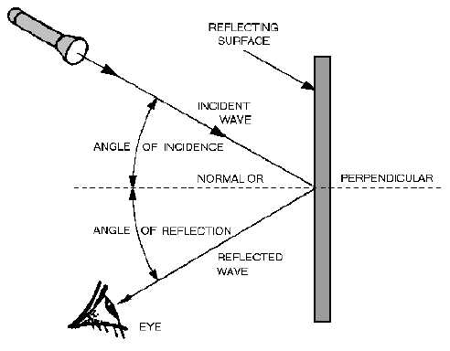

Slide 3
Explanation of figure 5
Figure 5 shows a light wave from a source (torch) which is projected to a reflecting surface. The light from the torch is the incident wave and strikes the reflecting surface at an angle of incidence. And the reflected wave forms the angle of reflection. In the above case the angle of incidence is equal to the angle of reflection. The law of reflection states that the angle of reflection equals the angle of incidence. This law is further explained in figure 6 below.

Slide 4
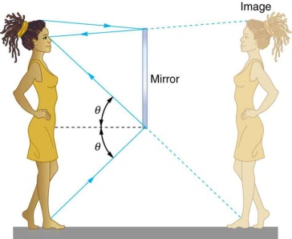
Law of reflection

Slide 5
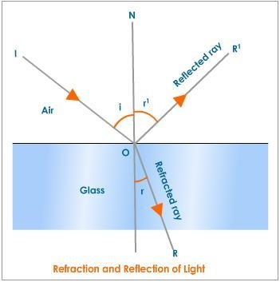
Refraction
Refraction of light happens when the angle of reflection is less than some critical angle of. (see figure 8 below).

Slide 7
Critical angle
Critical angle
In fiber optics, the critical angle is described with respect to the parallel axis running down the middle of the fibre and is 90 degrees.

Slide 8
Components of an optic fibre
The optic fibre is made up of three components:
Light source
Transmission system
Light detector
The detector generates an electric pulse when hit by light. A binary 1 means a pulse of light and a binary 0 means a pulse of light is missing.

Slide 9
The optic fibre is made up of three sections:
Core
Cladding,
Coating(also called the jacket)

Slide 10
The core carries the light signals
Cladding keeps the light in the core.
The coating or jacket protects the cladding.
The optical fibre operates on the principle of total internal reflection.
The light rays are reflected and guided down the length of the optical fibre.)

Slide 11
The acceptance angle of the fiber determines which light rays will be guided down the fiber. (see figure 8 below

Slide 12
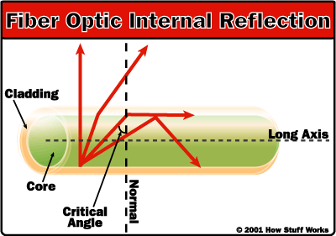

Slide 13
The source of light is either:
light emitting diodes (LEDs) or laser.
The core serves as a wide guide.
Assume the refractive index of the core is n₁ and that of the cladding is n₂,
Then n₁ > n_{2.}

Slide 14
Optic Fibre Transmission modes
There are three popular transmission modes:
Step index multimode
Graded step index multimode
Single step index mode

Slide 15
Multimode
The multimode step index:
has a little bit bigger diameter with common diameters in the 50-100 micro metre range for the light carry components.
In the United States, the most common diameter is 62.5ϻm.
Multi-mode links have data rates of 10 Mbit/s to 10 Gbit/s over link lengths of up to 600 meters (2000 feet).

Slide 16
Multi-mode fiber has a fairly large core diameter - enables multiple light modes to be propagated
- limits the maximum length of a transmission link due to modal dispersion.
- long cables greater than 914.4 metres has multiple paths of light can cause signal distortion at the receiving end resulting in an unclear and incomplete data transmission.

Slide 17
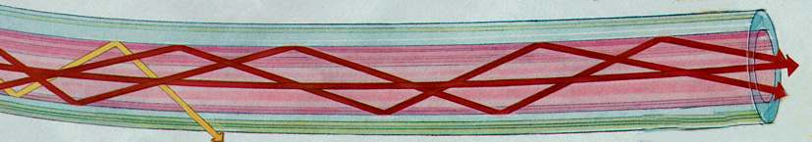
Multimode step indexes
The multimode step index is used when performance is not important

Slide 18
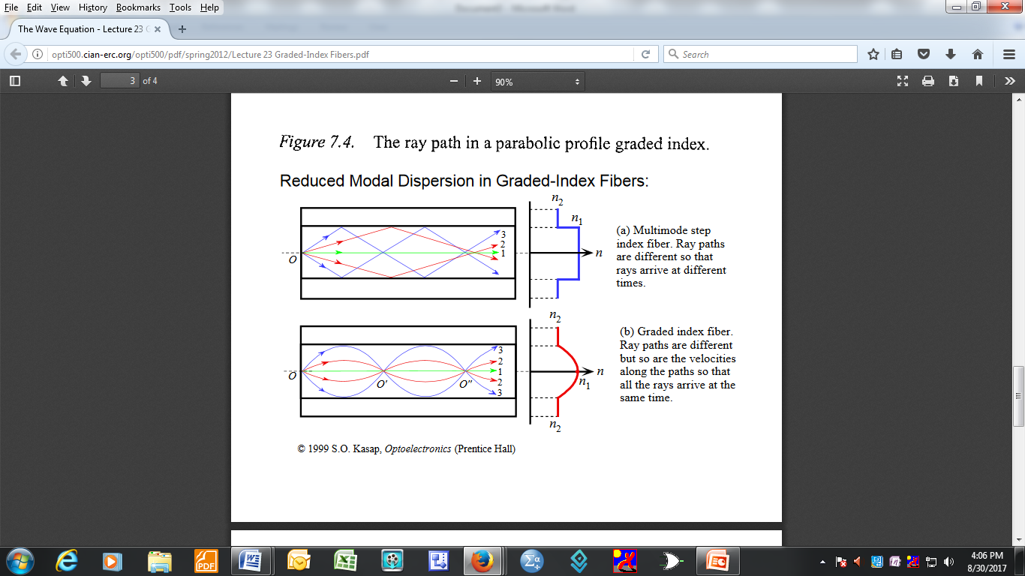
Another example of multi-mode step index

Slide 19
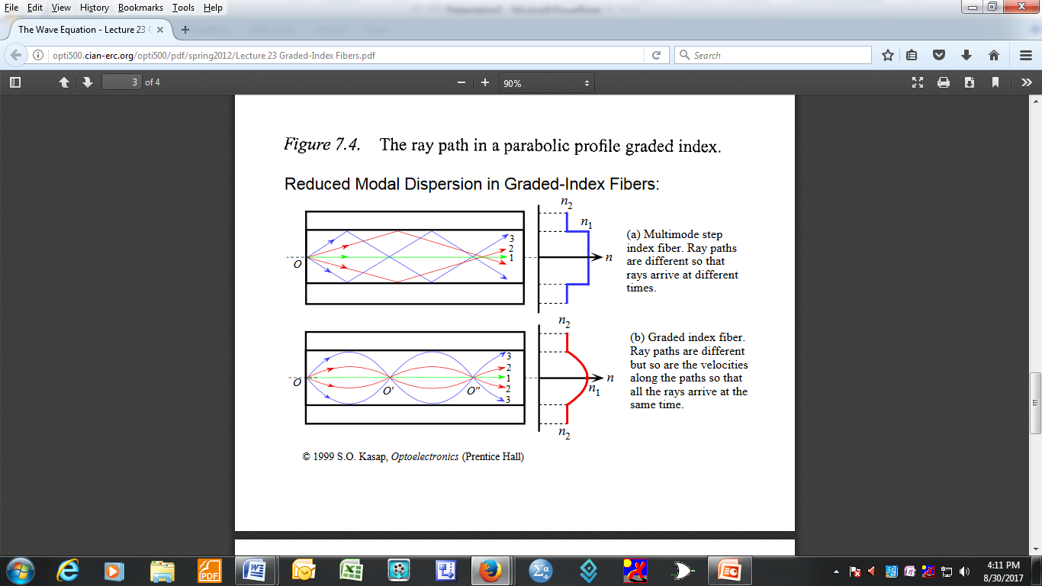
Multi-mode graded step index

Slide 20
Multi-mode graded step index
has a non uniform core.
The index is highest at the centre of the core
It gradually decreases until it matches that of the cladding.
there are no sharp transitions (zigzagging) between the core and the cladding.
This reduces modal dispersion.

Slide 21
Most common graded index fibres have a core diameter of 50 or 62.5 microns and a cladding diameter of 125 microns.
This type of optic fibre is popular in applications requiring a high bandwidth especially:
telecommunications, local area networks, computers and video applications.

Slide 22
Single-mode fibre
The core’s diameter is reduced until the fibre propagates only one mode efficiently.
Single mode has a very small diameter of only 5-12 microns.
Light travels parallel to the axis creating very little pulse dispersion.
Telephone and cable television networks install millions of kilometres of this fibre every year.

Slide 23
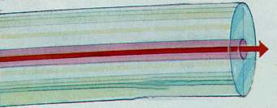
Single mode optic fiber

Slide 24
The cladding is about 10 times thicker than the core for example if the core is 8 or 9 microns, the cladding must be at least 80 microns.

Slide 25
Advantages and disadvantages of optic fibre transmission
Isolation from noise (noise immunity)
High data bandwidth
Minimum signal attenuation compared to wire transmission
Light weight compared to wires
Signals can be transmitted at broad bandwidth over a long distance
Secure means of communication and is immune to most environmental conditions.

Slide 26
Disadvantages
High installation costs
Susceptibility to physical damages and difficult to repair
Special test equipment is often required
Wild life damage to optic fibre cables, for example birds use material of the optic fibre jacket as nesting material.
Beavers use the exposed fibre to sharpen their teeth.

Slide 27
Disadvantages (continued)
When laid under water sharks damage the fibre by chomping on it and ants use the jacket material as part of their diet.

